Slide 1
BigData Spark Hands-On 3 [part2] launching spark on k8s
arnaud.nauwynck@gmail.com
Esilv 2024

Slide 2
Outline
Install podman (~Docker) on local Windows/Mac/Linux
Install Kubernetes Cluster "Kind" (=K8s in Docker)
Install Kubernetes Tools: k9s, helm, aliases
Install spark-operator for K8s using Helm + check/fixes
(Optional) Launch spark-shell on Docker, in mode "--master local[*]"
(Optional) Launch spark with "spark-submit --master k8s://localhost:port"
Launch spark with "kubectl apply -f file.yaml"
(Optional... and backup if local install fails) Using Azure Kubernetes
part 1/2

Slide 3
"KISS" = Keep It Stupid Simple kubectl apply -f spark-pi.yaml

Slide 4
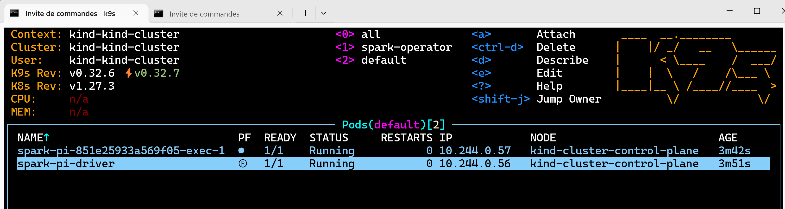
Check running

Slide 5
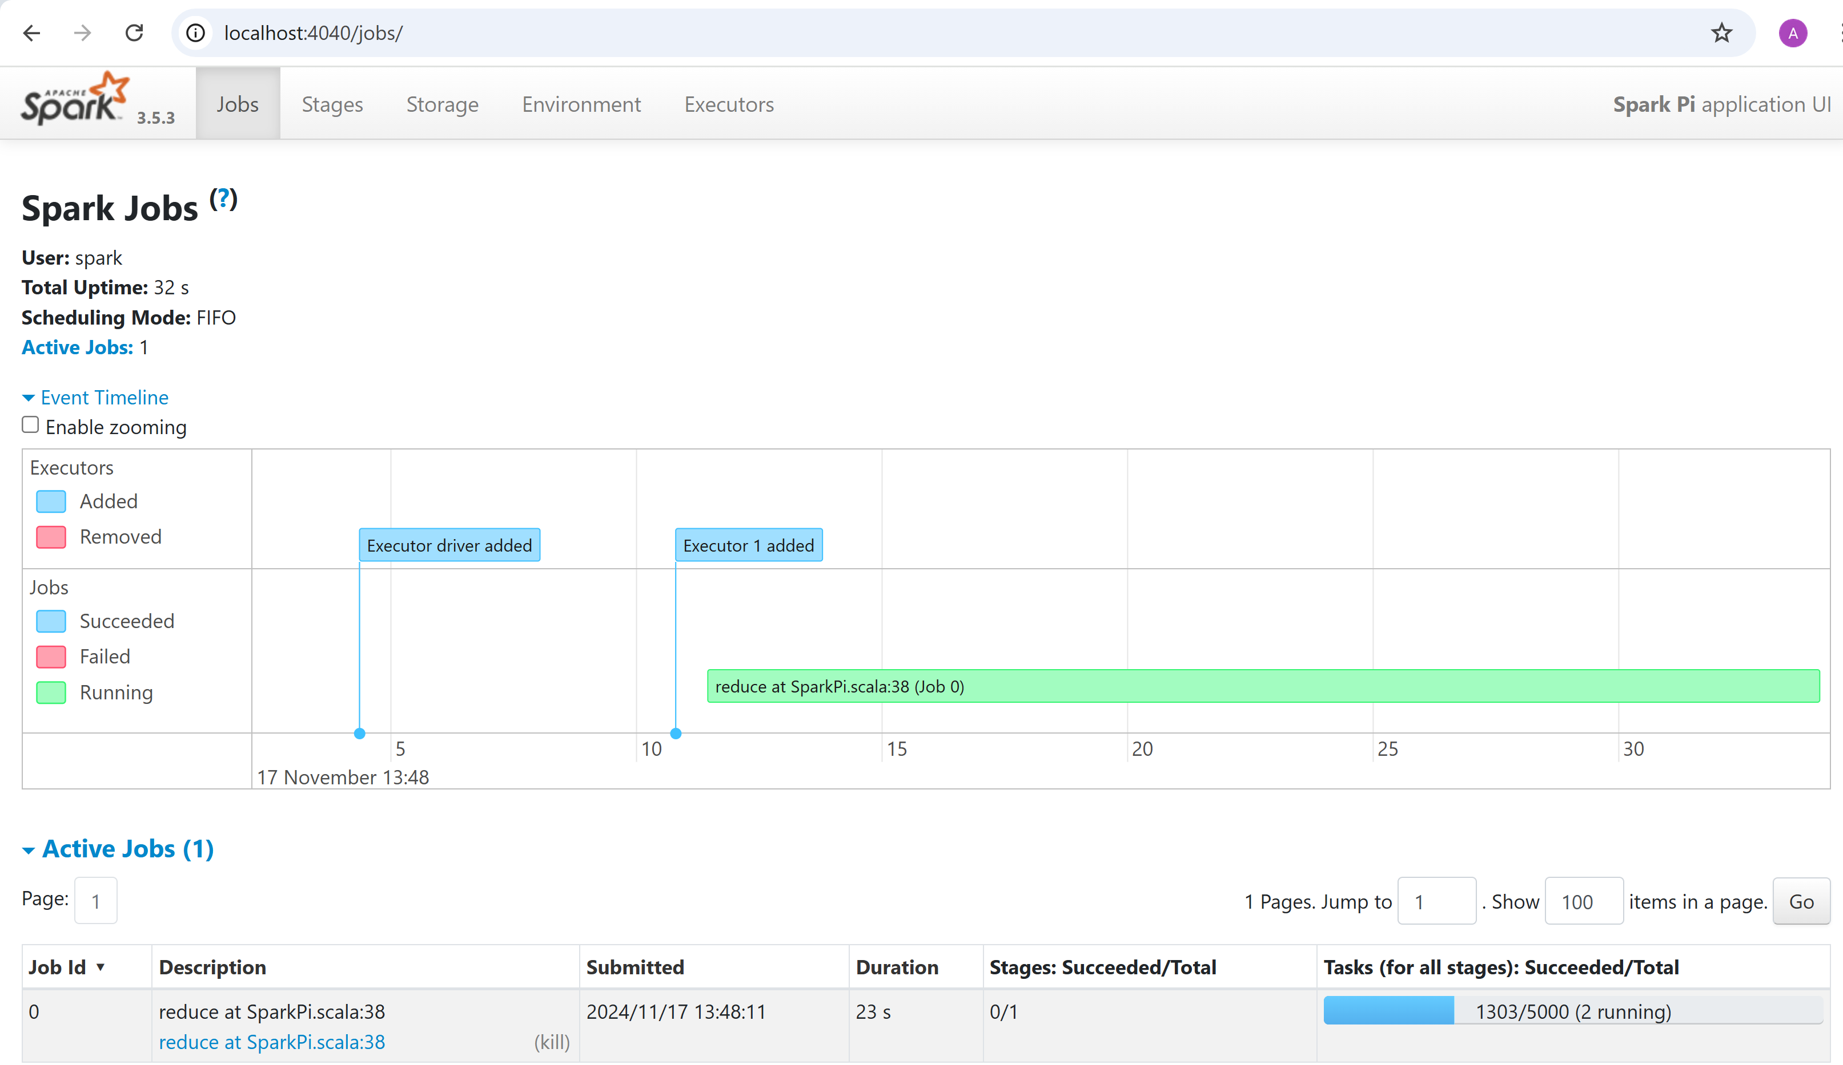
do "port forward" 4040 (in driver pod) -> 4040 on localhost
kubectl port-forward spark-pi-driver 4040:4040
Then open your browser on htttp://localhost:4040

Slide 6
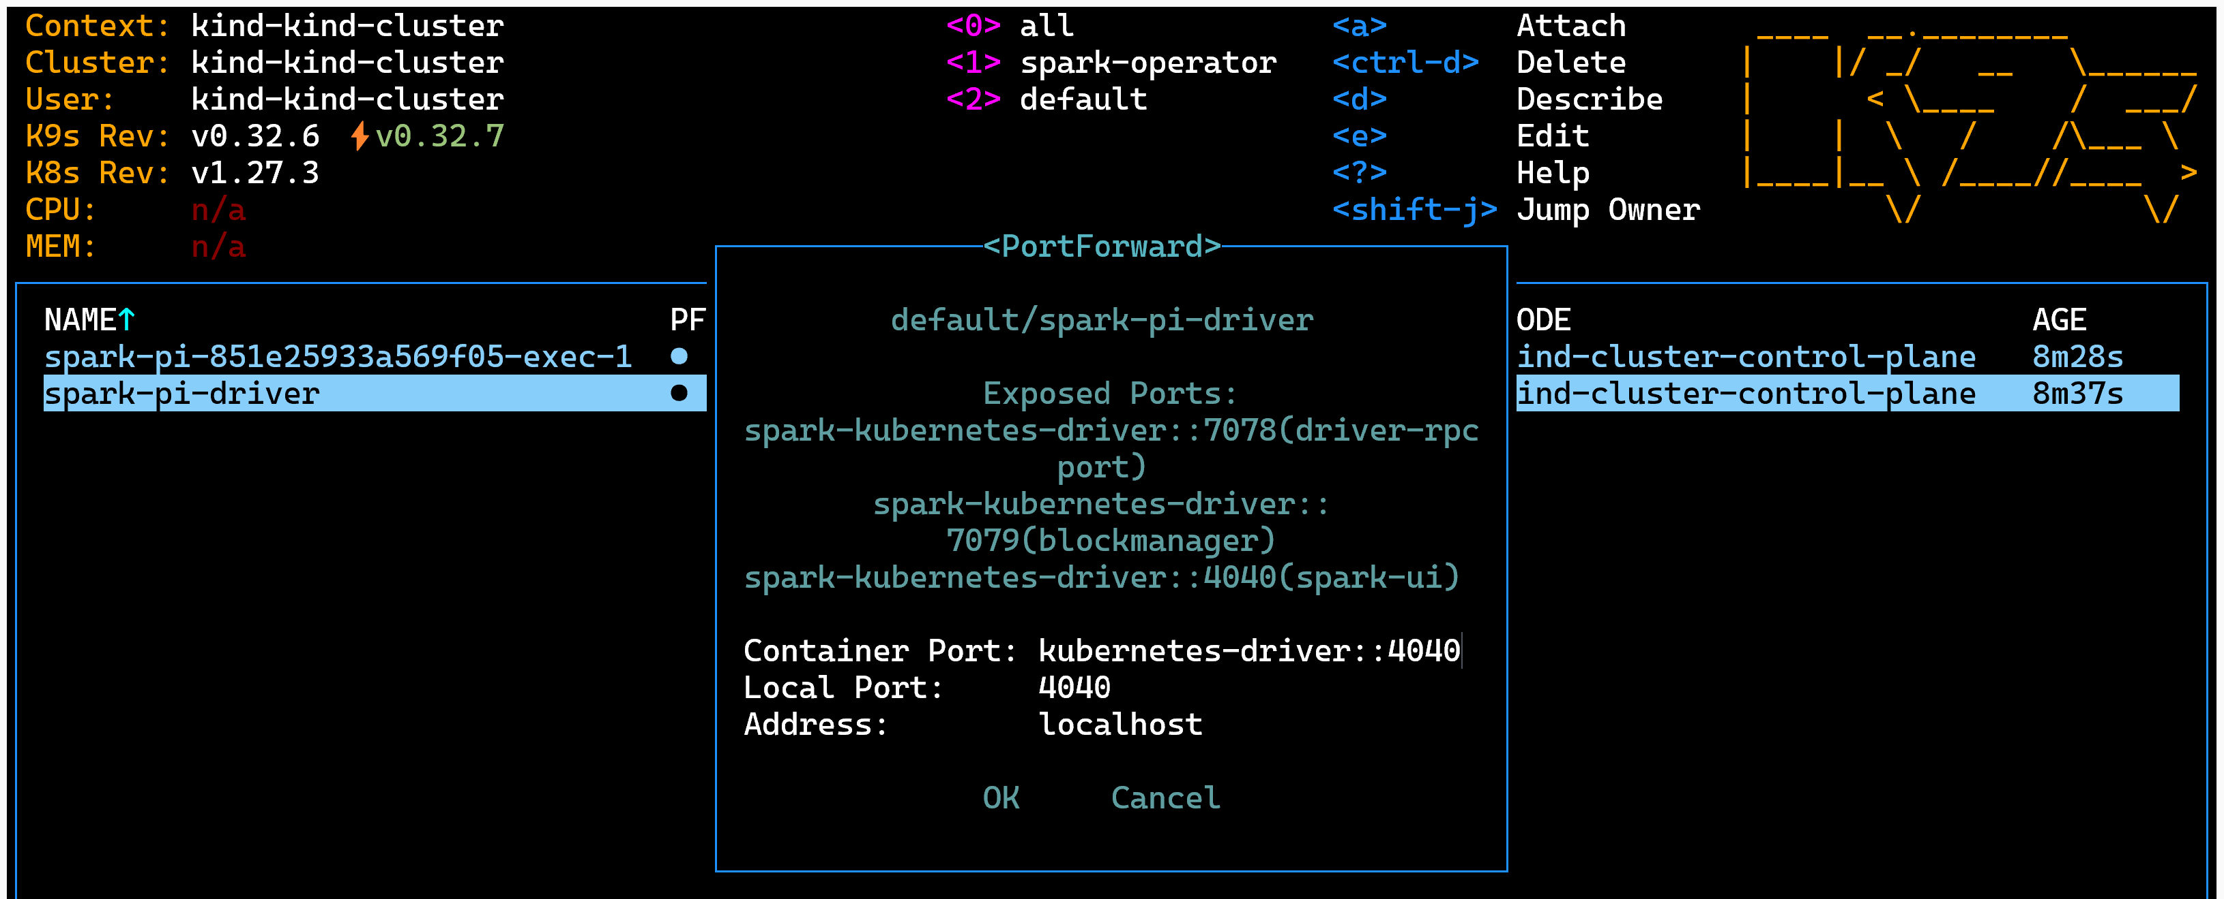
Alternative: do port-forward using K9s
select pod "spark-pi-driver", type "<CONTROL> + F", edit port number "4040", then "OK"

Slide 7

It just works

Slide 8
Next Steps - Personnal Study
- try to relaunch several times, how to do?
- explore the internals of spark-operator + k8s pods
- change parameter to use several executors, and different cores number
- provide your own jar and className to execute
- execute a "shell" inside the spark-executor/driver to monitor unix process
- add environment variable to the driver/pod
- choose env variable _JAVA_OPTIONS to enable remote JVM debugging
then attach debugger as "remote java process"
- use ConfigMap from k8s to be visible as mounted volume files
- use "emptyDir" mount volume for shuffle files
- etc etc

Slide 9
Dive Deeper, Understand the Magie & TroubleShoot Errors

Slide 10
running your first "Docker" spark image

Slide 11
running spark image in Docker "local" mode
docker run -it apache/spark /opt/spark/bin/spark-shell
OR
podman run -it apache/spark /opt/spark/bin/spark-shell

Slide 12
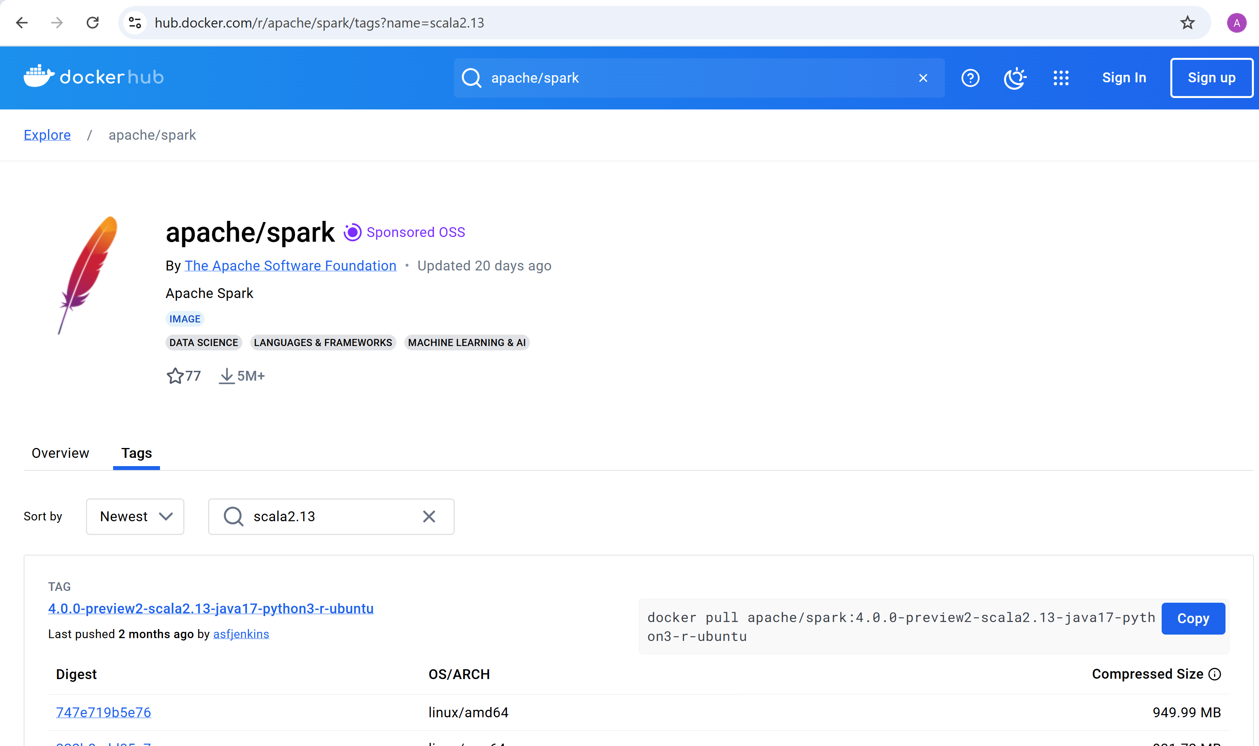
Docker HUB spark "latest" image ? example: finding with scala2.13 (!= 2.12)

Slide 13
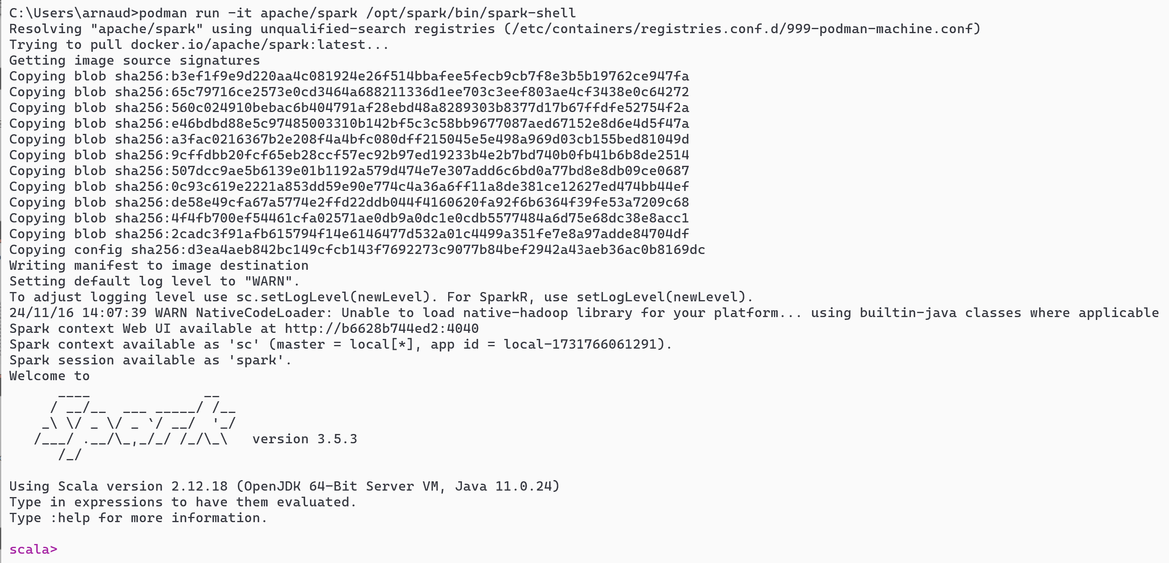
spark-shell --master local[*] in Docker
podman run -it apache/spark /opt/spark/bin/spark-shell

Slide 14
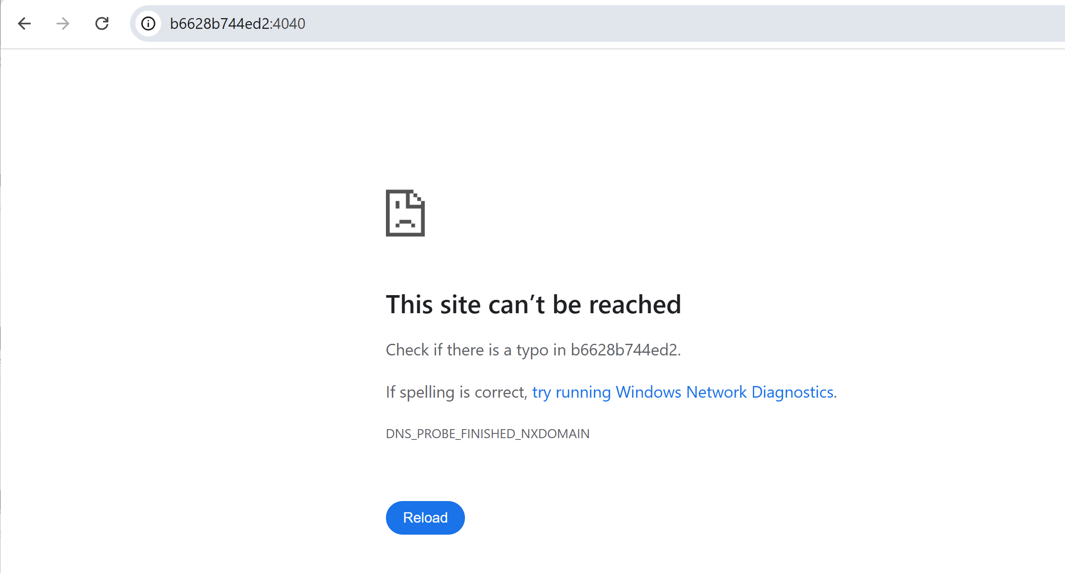
open SparkUI ? localhost ? temporary "vm name" not found

Slide 15
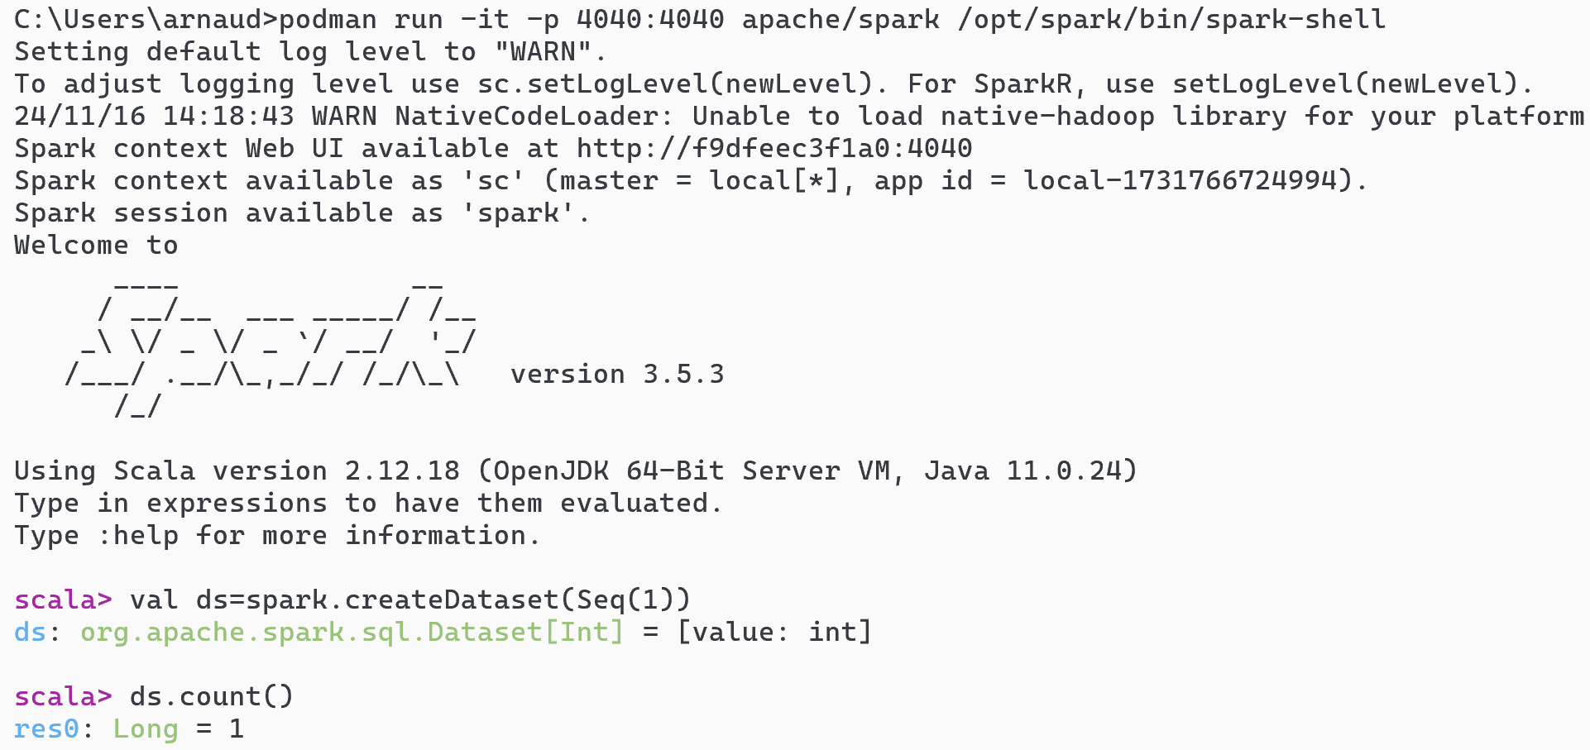
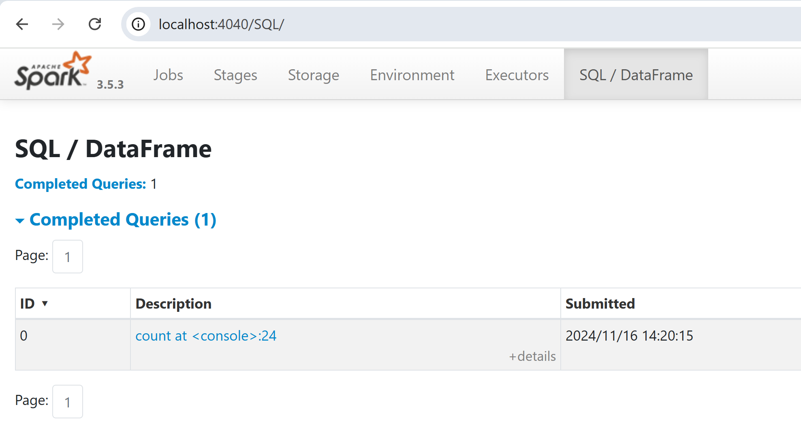
Need port-forward
podman run -it -p 4040:4040 apache/spark /opt/spark/bin/spark-shell

Slide 16
ok... running "docker java" instead of "java" but not yet using "--master k8s://k8s-api-server" still using "--master local[*]"

Slide 17
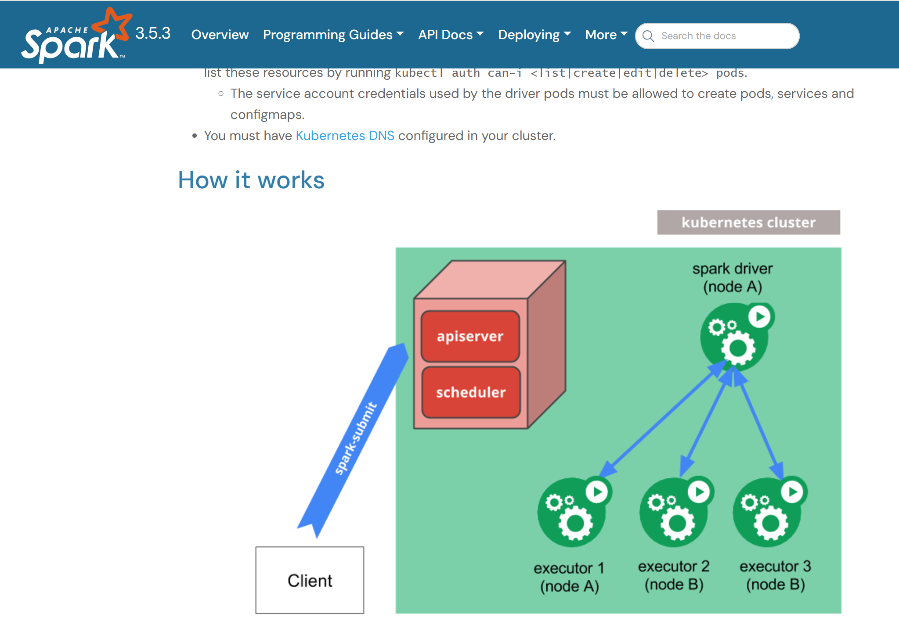
built-in in Spark (java/scala) code : --master k8s://
https://spark.apache.org/docs/3.5.3/running-on-kubernetes.html

Slide 18
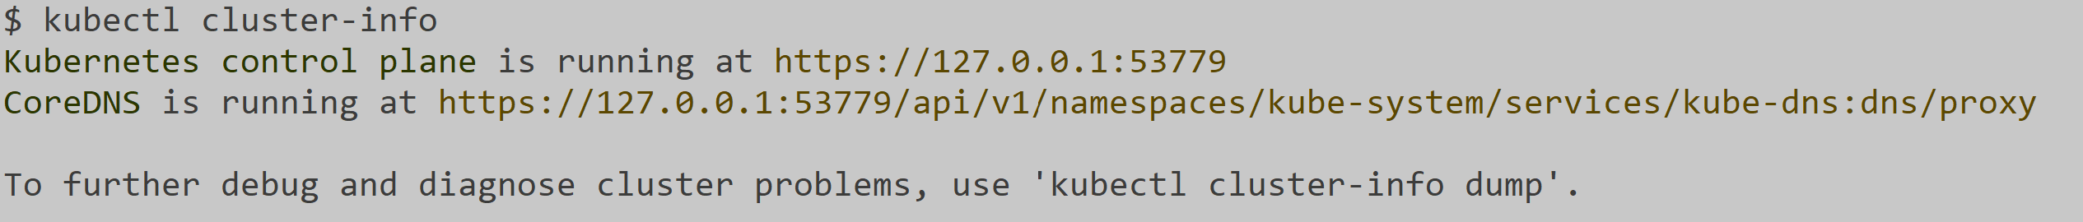
kubectl cluster-info => local k8s Api server : port

Slide 19
doc example --master k8s://localhost:port
spark-submit \
--master k8s://https://localhost:port \
--deploy-mode cluster \
--name spark-pi \
--class org.apache.spark.examples.SparkPi \
--conf spark.kubernetes.container.image=apache/spark:latest \
local:///path/to/examples.jar

Slide 20
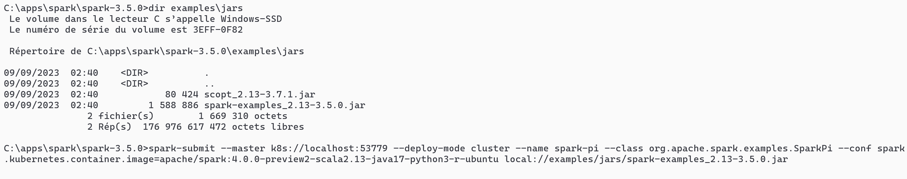
Command ... for local spark
spark-submit --master k8s://localhost:53779 --deploy-mode cluster --name spark-pi --class org.apache.spark.examples.SparkPi --conf spark.kubernetes.container.image=apache/spark:4.0.0-preview2-scala2.13-java17-python3-r-ubuntu local://examples/jars/spark-examples_2.13-3.5.0.jar
INVALID ... on purpose (can skip question, or investigate)
... PENDING ???

Slide 21
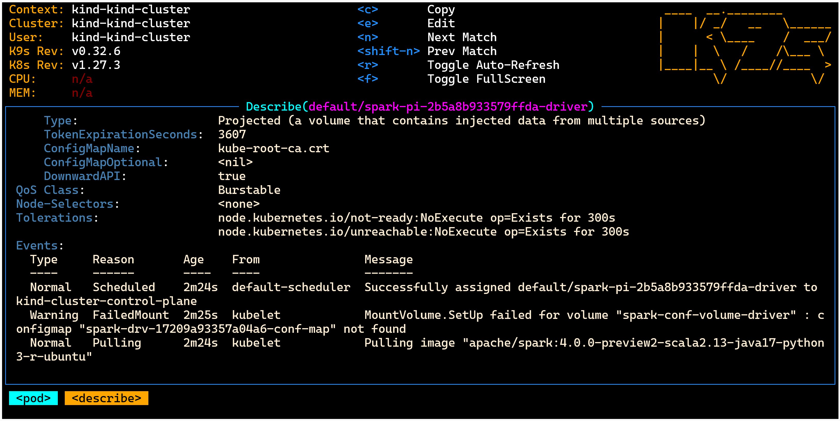
Pending few minutes (intermediate Warning "MountVolume failed" will be auto resolved with wait+internl retry )

Slide 22
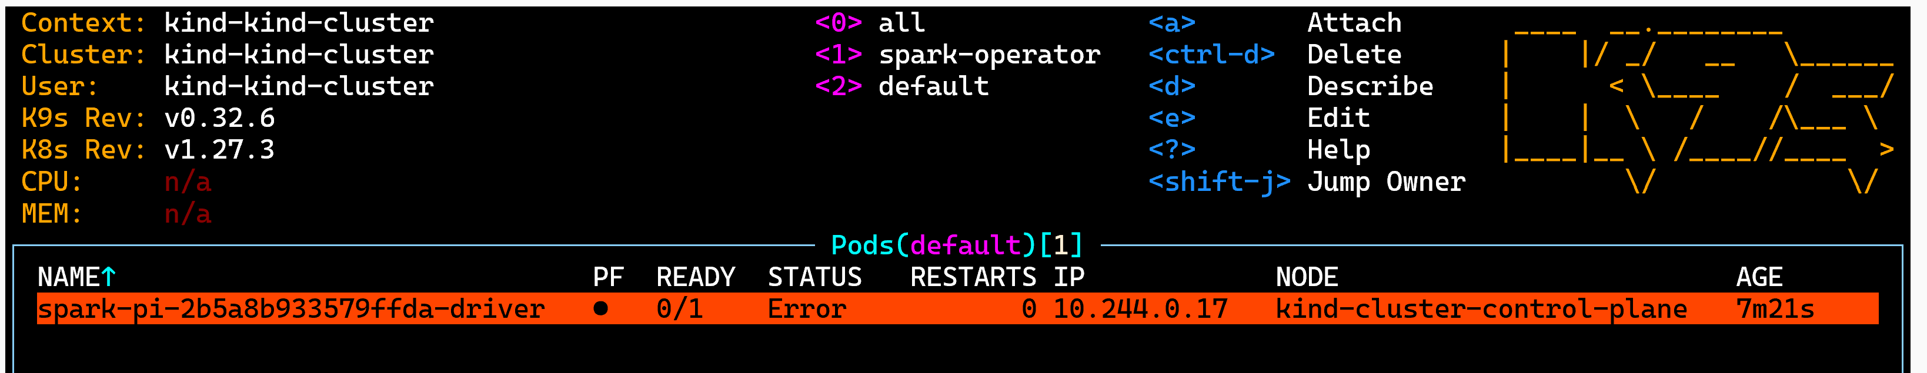
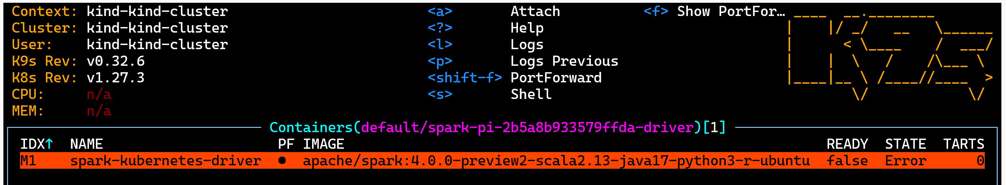
Diagnosing Error : K9s - pod
K9s pod "driver" -> container "spark-kubernetes-driver"

Slide 23
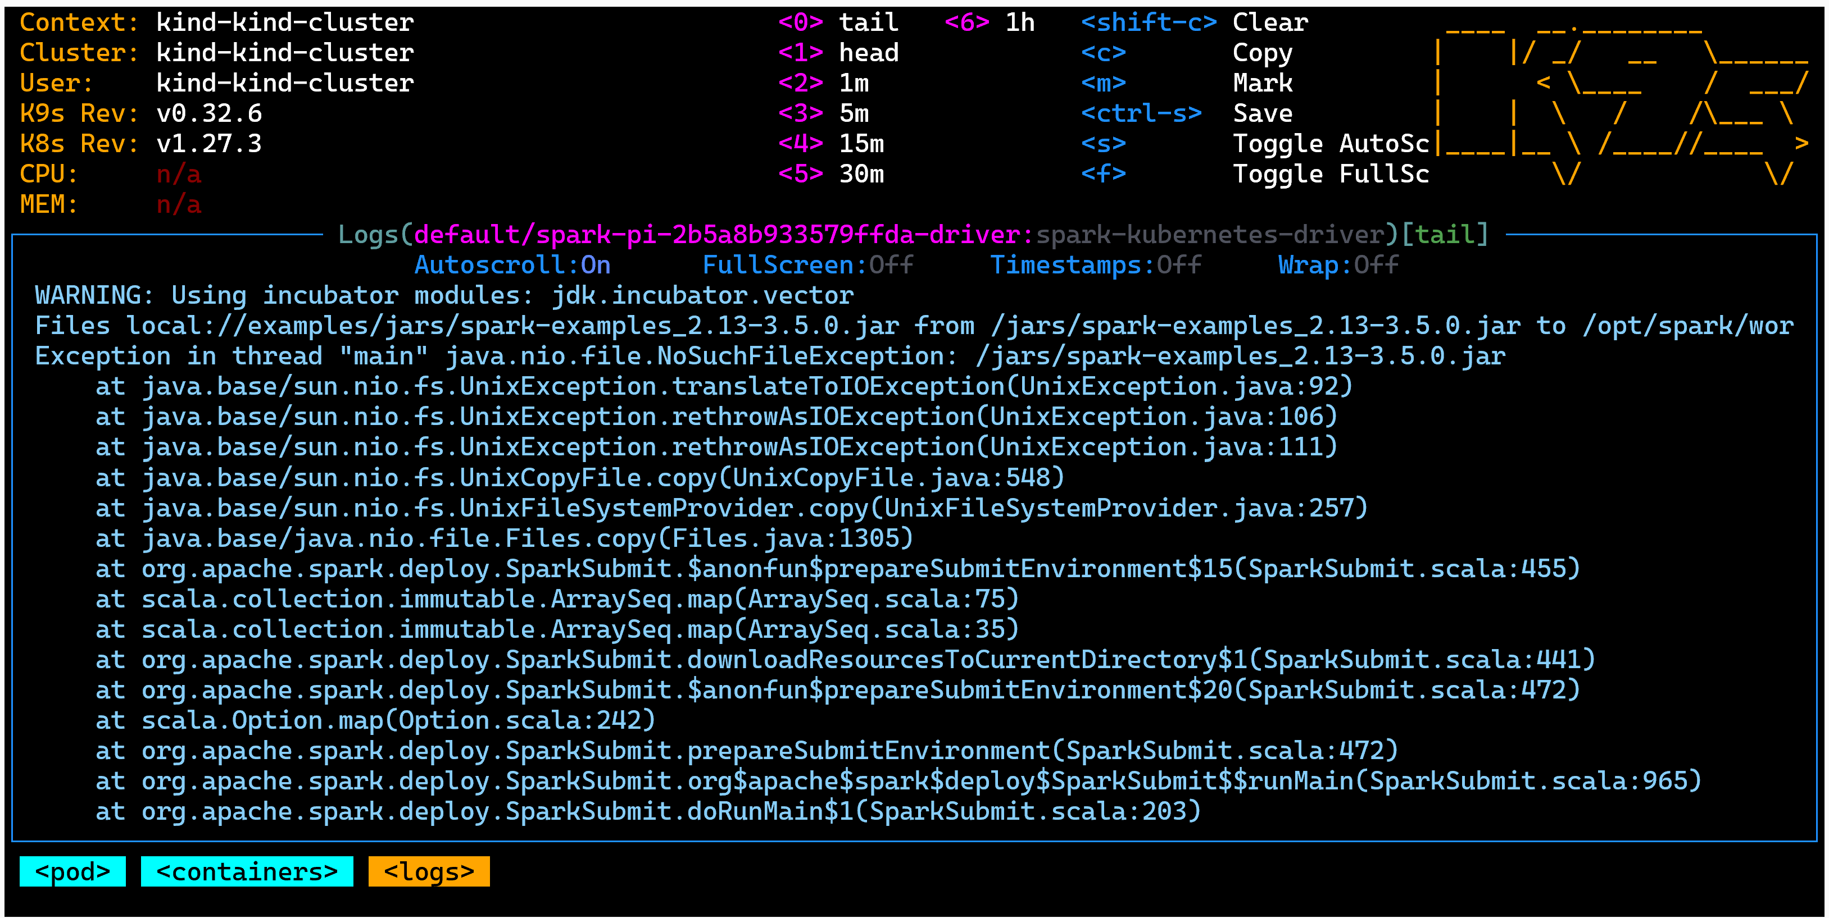
k9s pod - container - log ... jar file not found

Slide 24
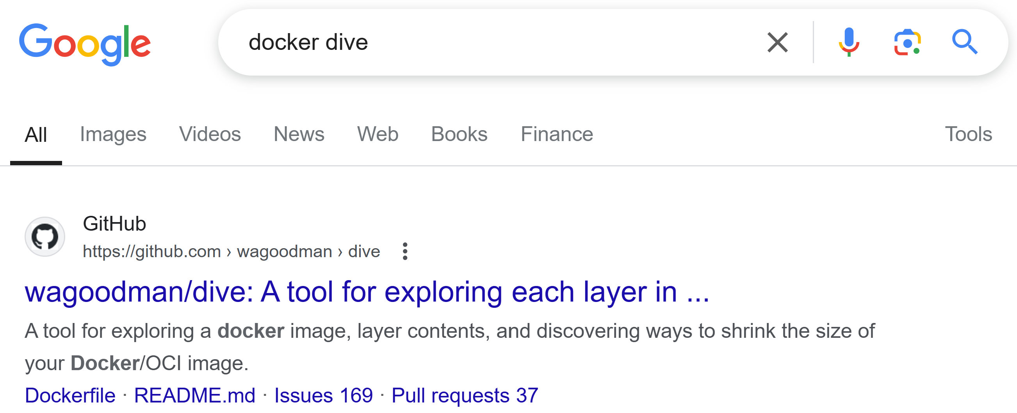
"local://" means a file already existing "inside" the image !
how to explore existing Docker Image content ? "dive"

Slide 25
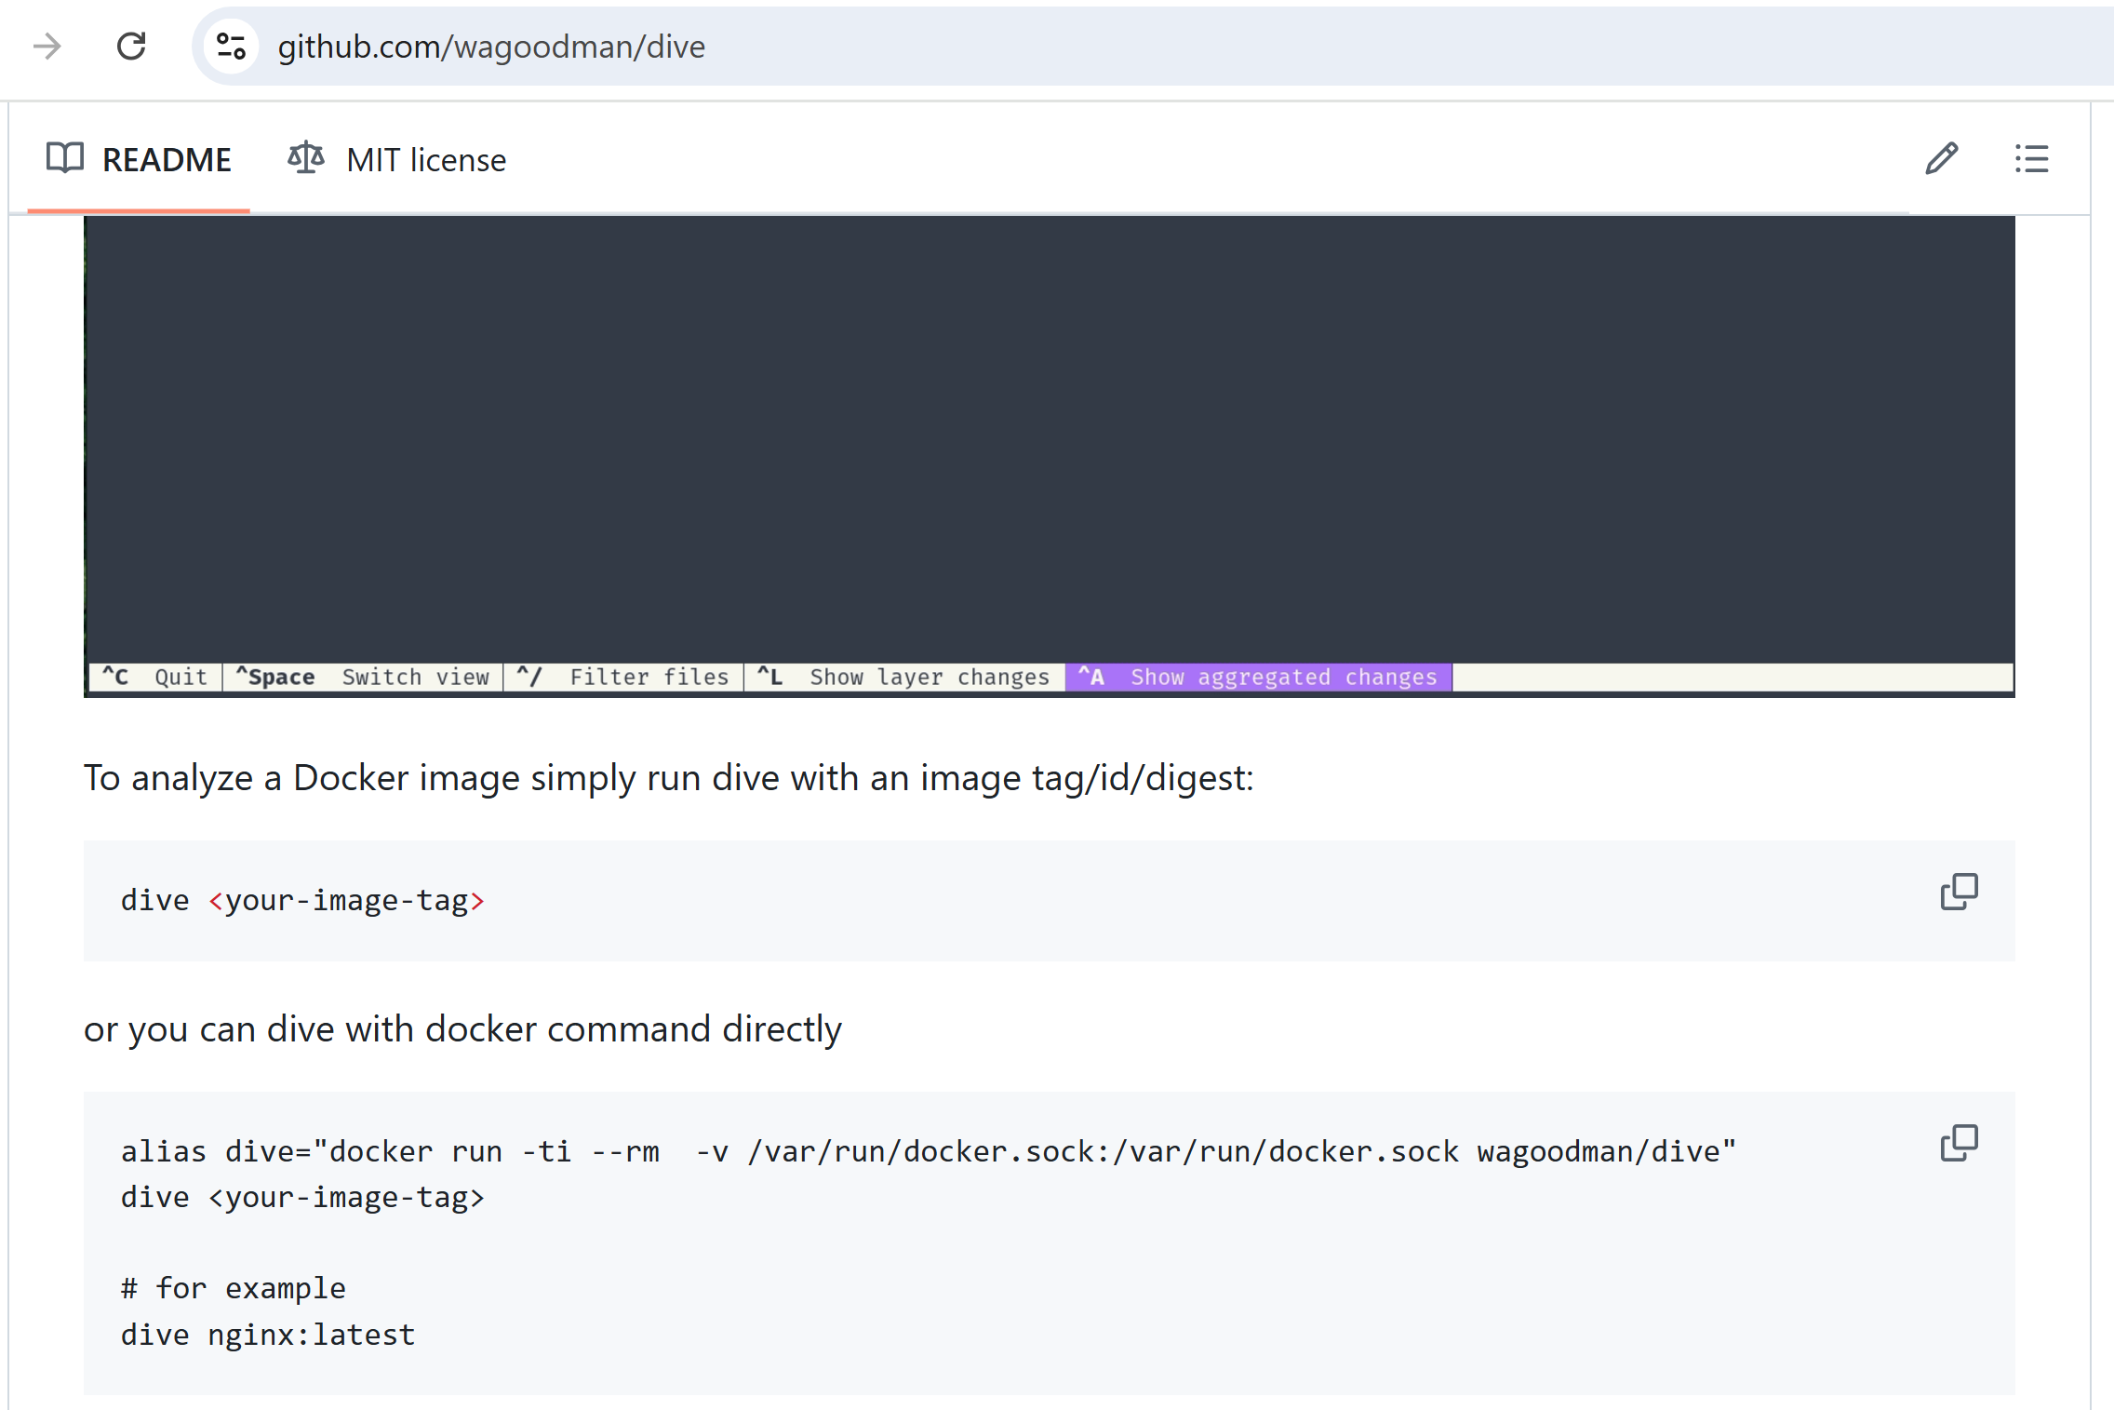
docker dive <<image>>

Slide 26
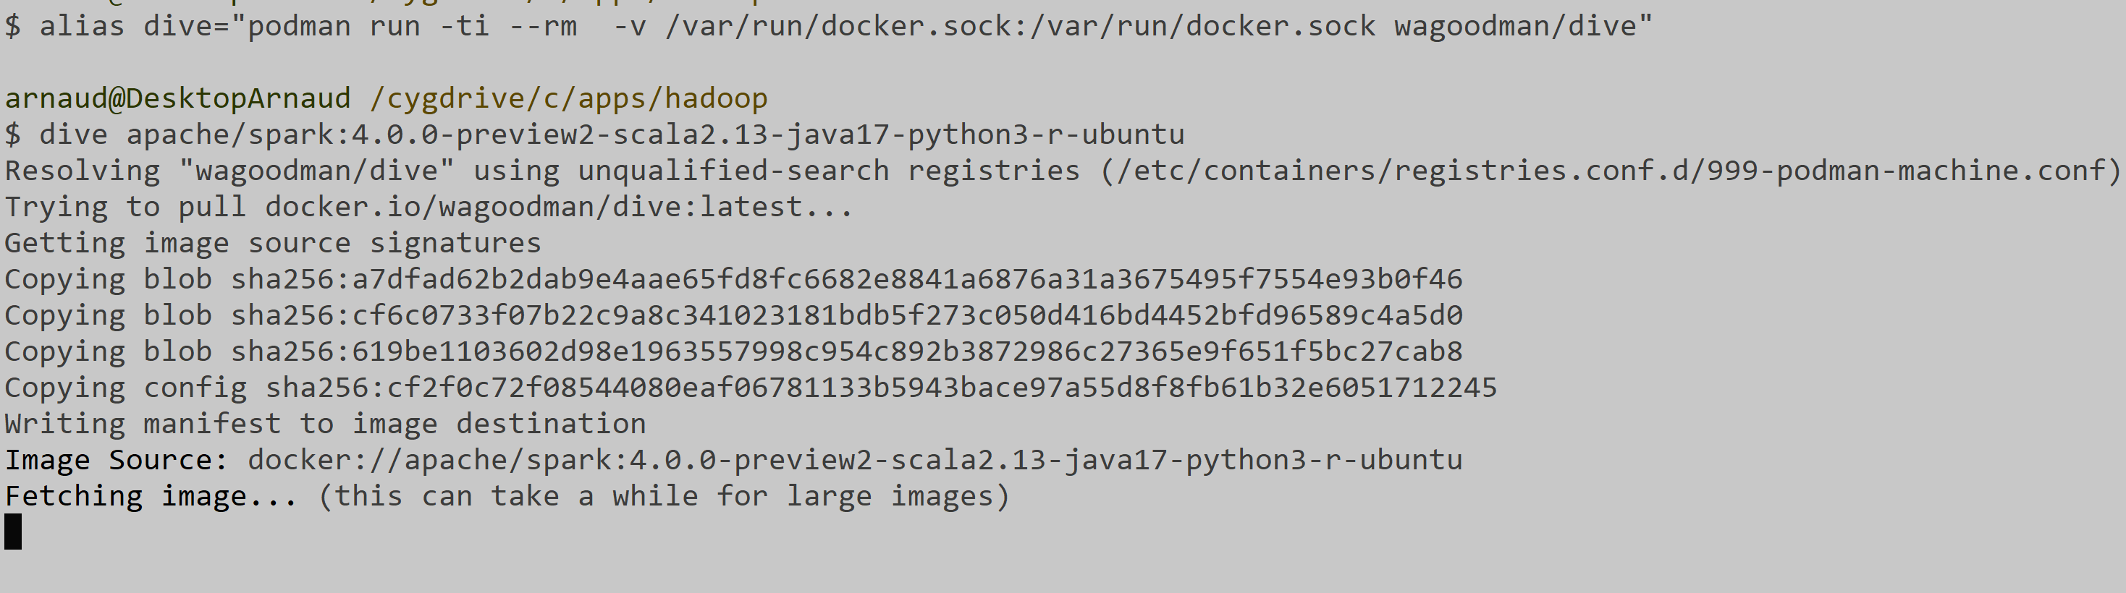
podman dive run -it wagoodman/dive <<img>>
podman run -ti --rm -v /var/run/docker.sock:/var/run/docker.sock wagoodman/dive apache/spark:4.0.0-preview2-scala2.13-java17-python3-r-ubuntu

Slide 27
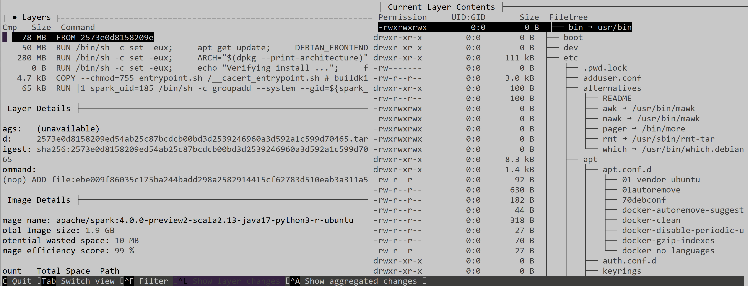
dive - browse layers

Slide 28
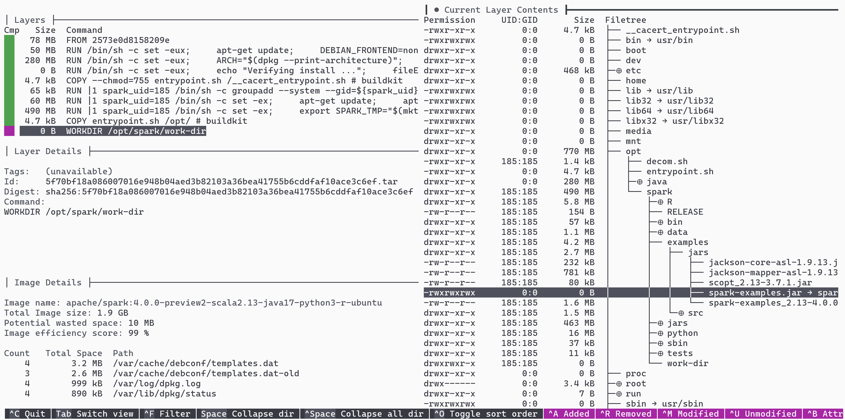
Navigate: on Layer step, then "->" for right pane then "<SPACE>" for collapse dir

Slide 29
alternative: docker run -it <<image>> "/bin/bash" ( if image contains a shell ) then # cd .. ; ls ; find

Slide 30
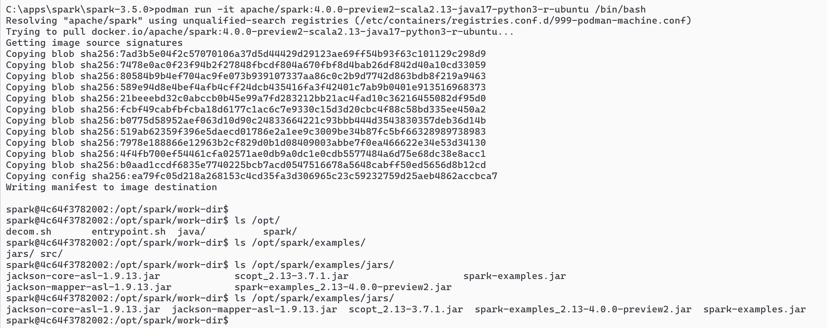
docker run -it
like "SSH" inside the pod container !

Slide 31
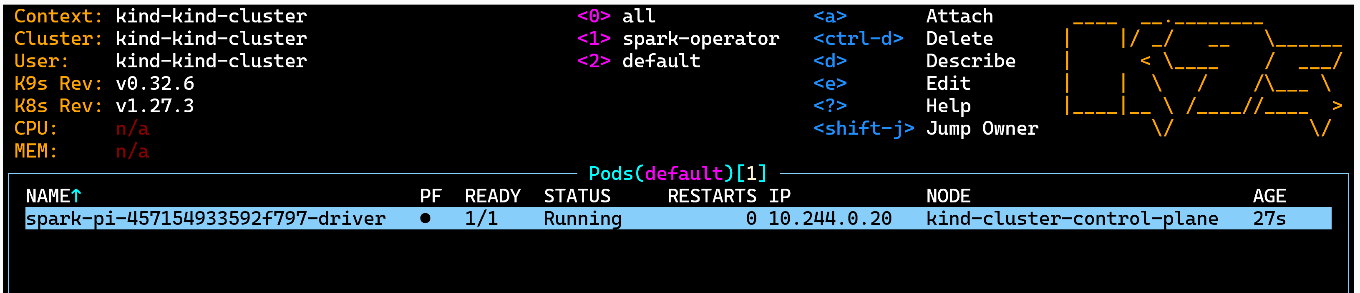
Relaunch => pod Running "spark-driver" but Failed to launch "spark-executor"
spark-submit --master k8s://localhost:53779 --deploy-mode cluster --driver-memory 1g --executor-memory 1g
--name spark-pi --class org.apache.spark.examples.SparkPi
--conf spark.kubernetes.container.image=apache/spark:4.0.0-preview2-scala2.13-java17-python3-r-ubuntu
local:///opt/spark/examples/jars/spark-examples.jar

Slide 32
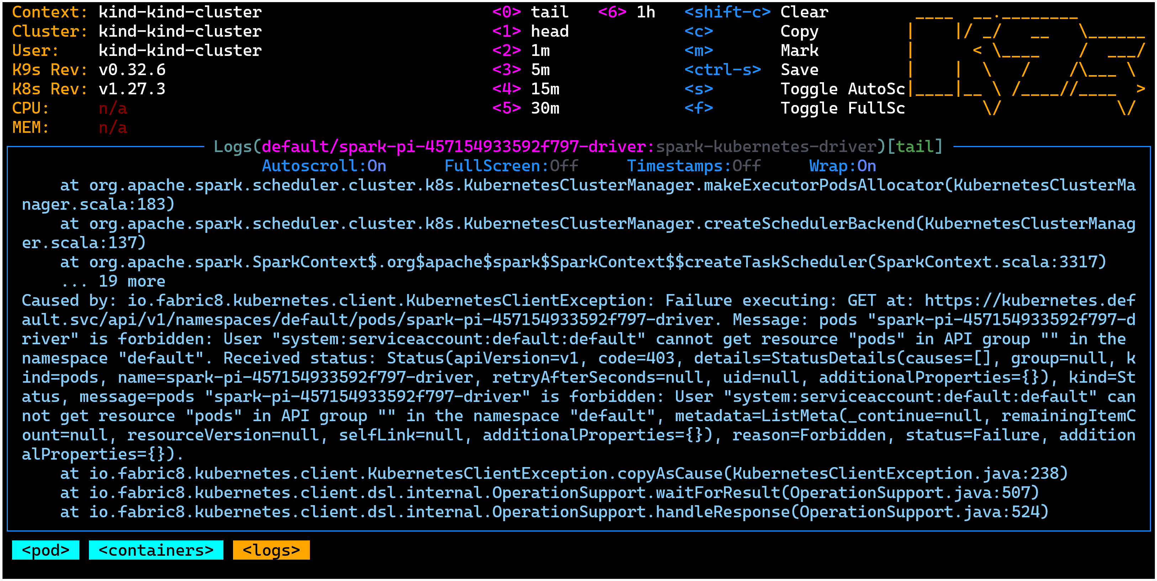
Failure : forbidden: User "...default" can not get resource "pods"

Slide 33
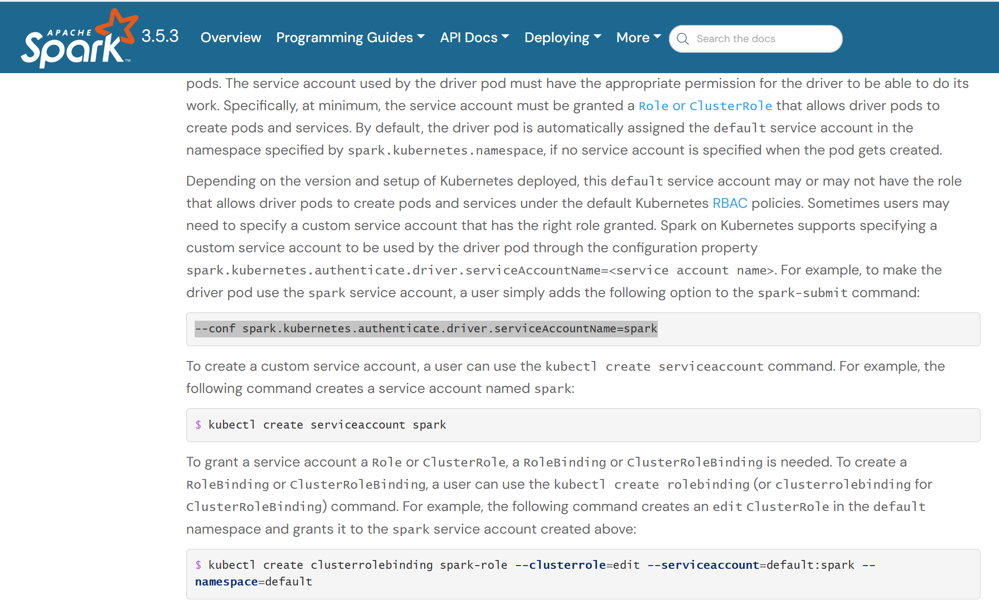
Doc serviceAccountName
https://spark.apache.org/docs/3.5.3/running-on-kubernetes.html

Slide 34
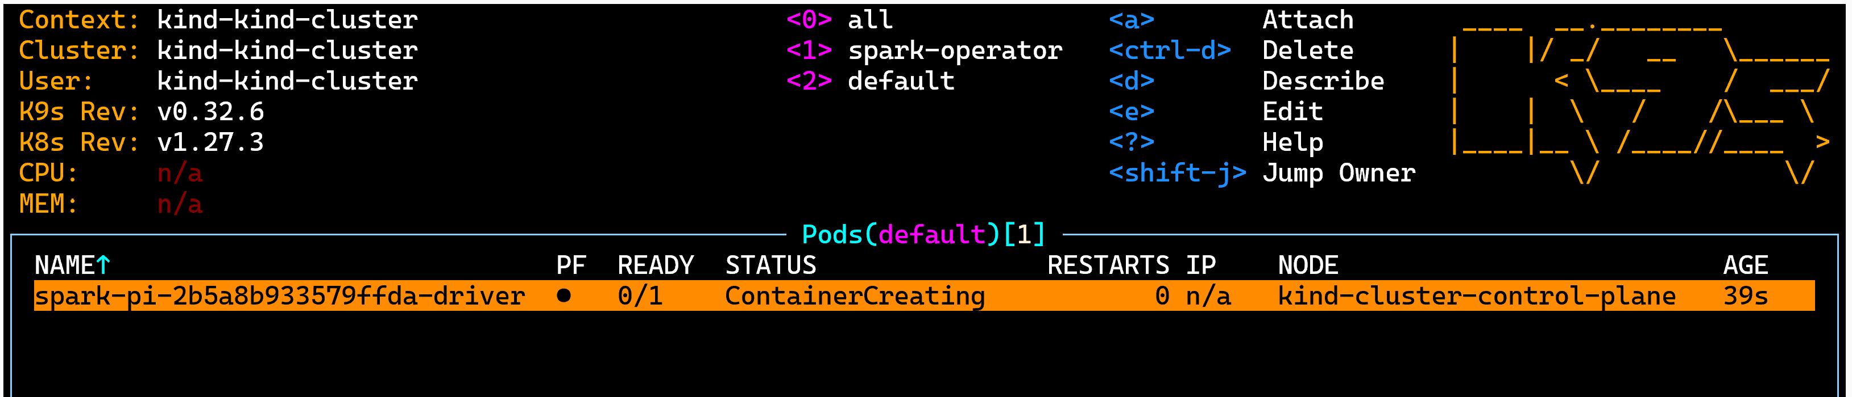
Relaunched: K9s pod - ContainerCreating

Slide 35
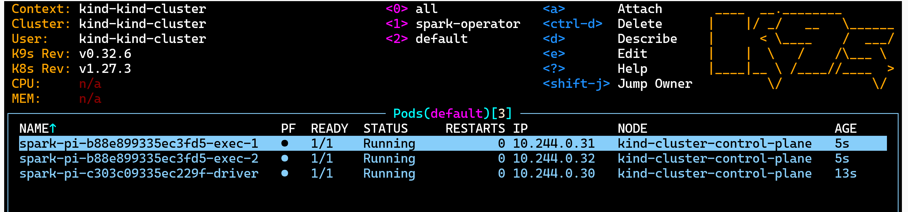
Relaunched: -> Running
Notice : 3 pods = 1 driver + 2 * executors

Slide 36
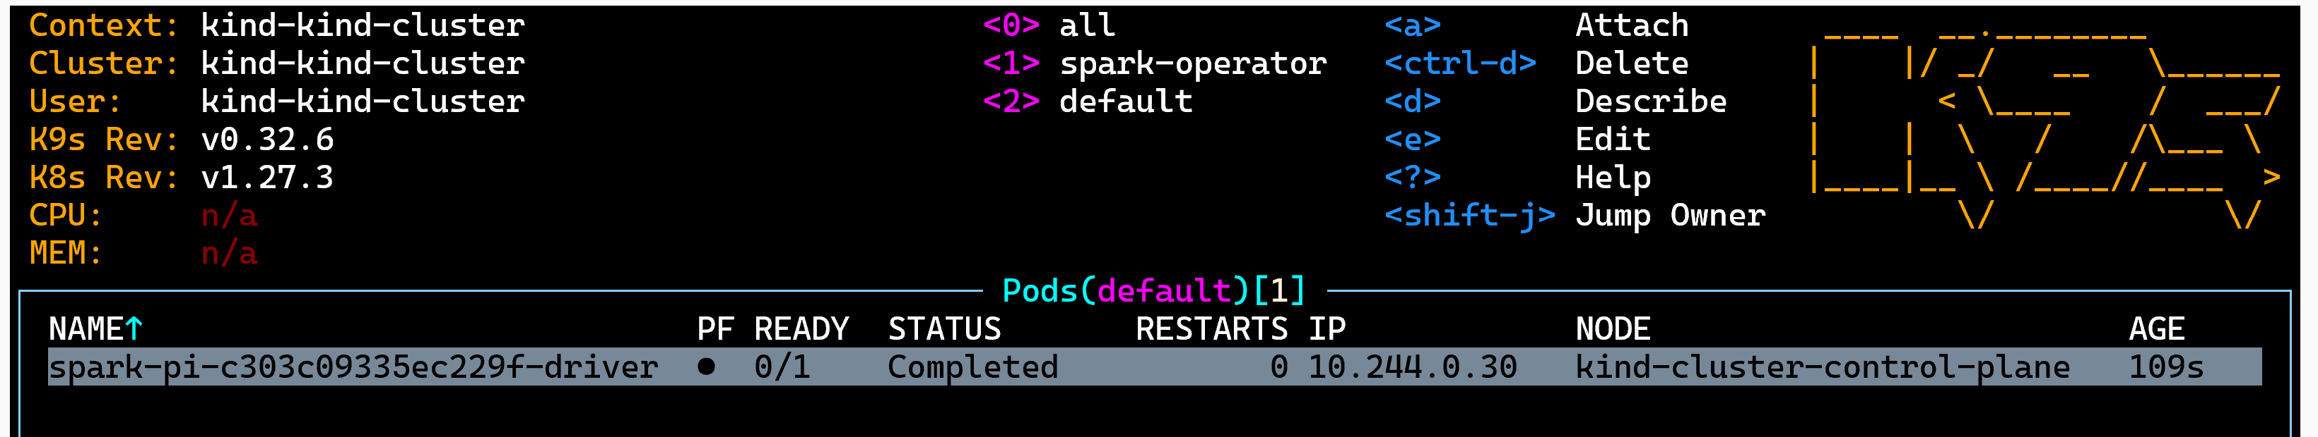
Relaunched .. Completed

Slide 37
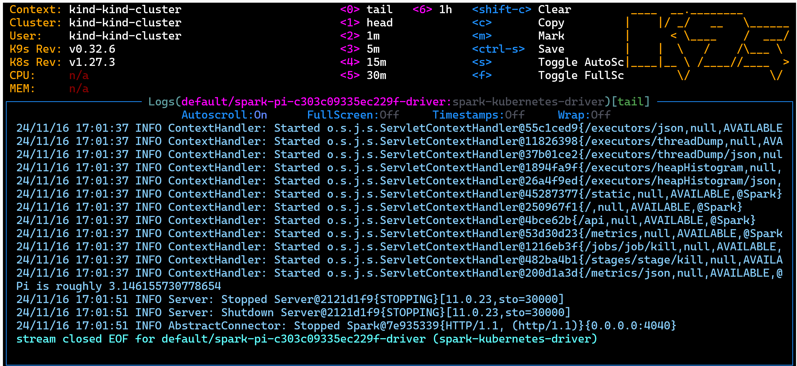
Completed - Logs

Slide 38
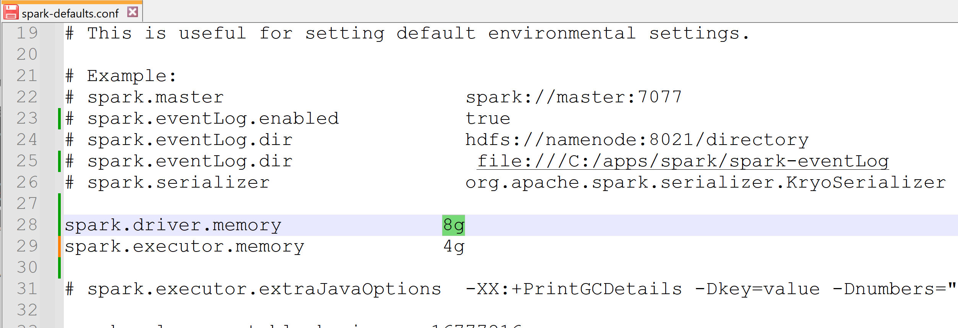
Scenario if/when requesting too much memory
spark-submit
--driver-memory 8g
...
OR
config file ${SPARK_HOME}/conf/spark-default.conf

Slide 39
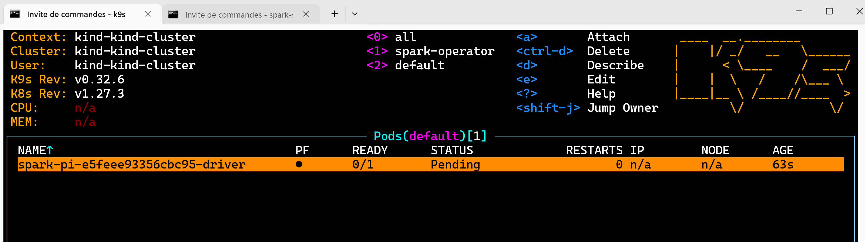
check in k9s (Pending Forever)

Slide 40
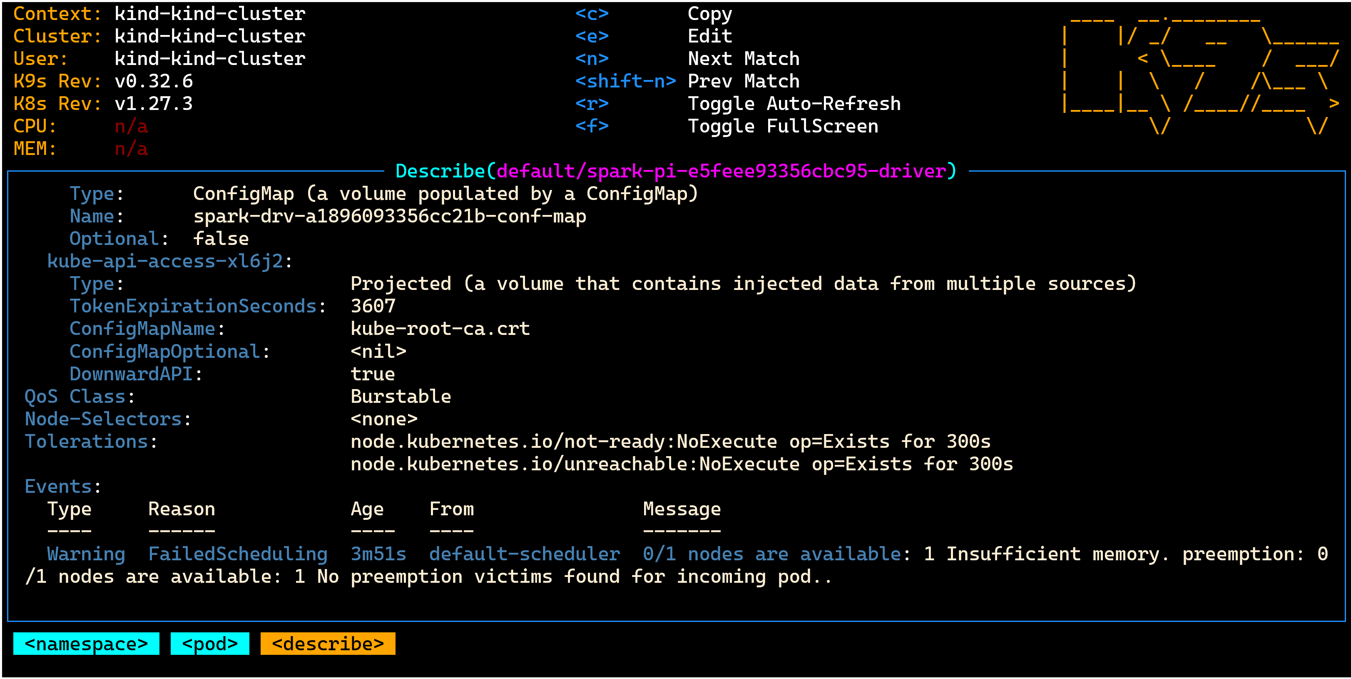
Debug "Pending" reason in K9s pod : "Insufficient memory"

Slide 41
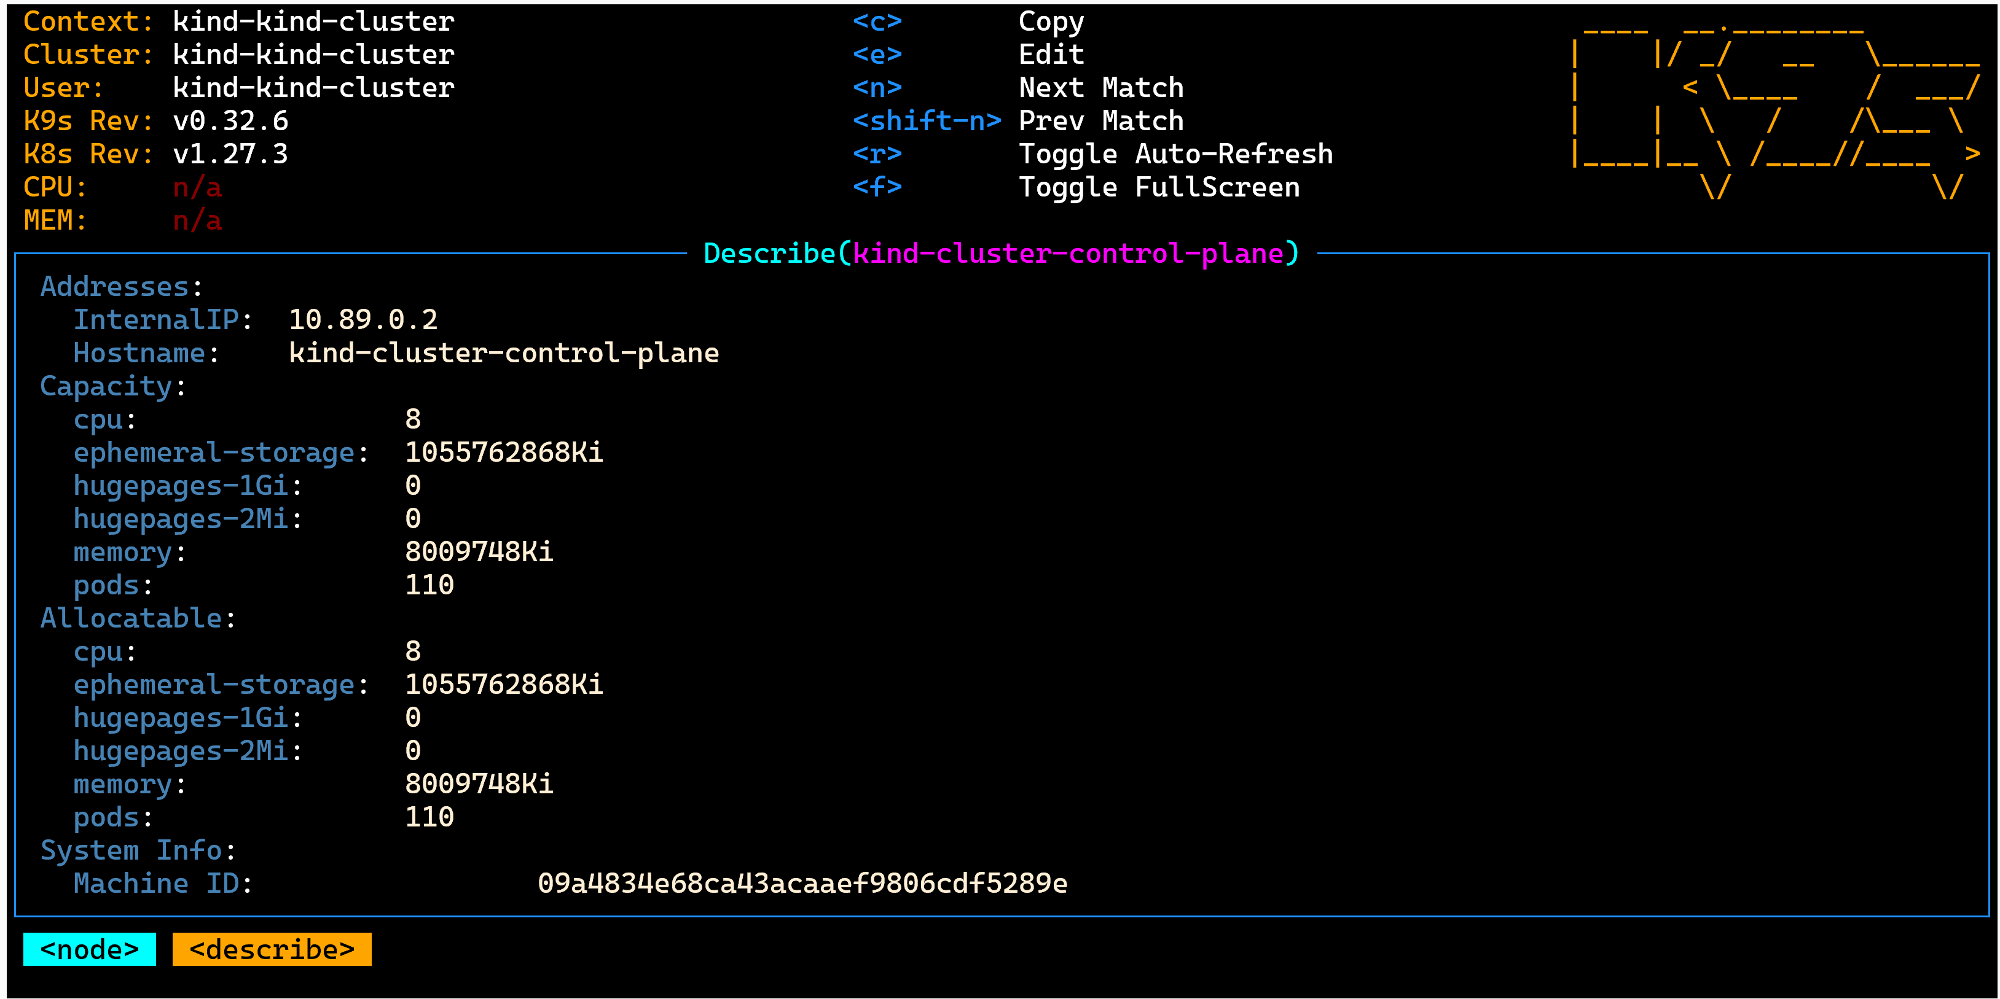
K9s node : Capacity -> Allocatable -> Free Memory?

Slide 42
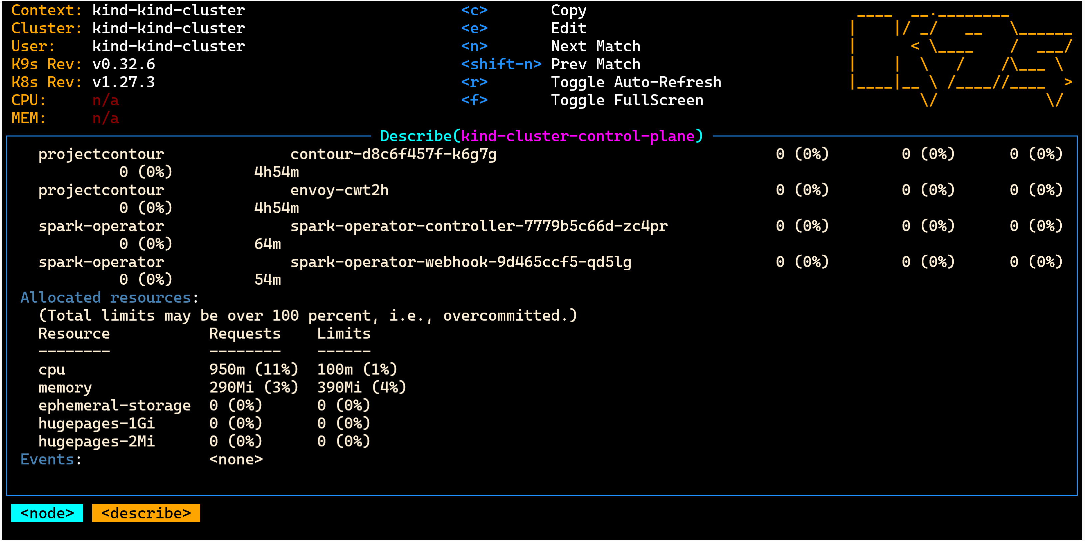
k9s node - Allocated / Free memory

Slide 43
Looks "acceptable" to run "--master k8s://" BUT it is NOT practical: no configMap created, no PVC, no Ingress, no Service.. => not sufficiently exposed/integrated in k8s

Slide 44
Time to launch for real using "kubetctl apply -f <file.yaml>" a.k.a. the K8s way (instead of spark-submit)

Slide 45
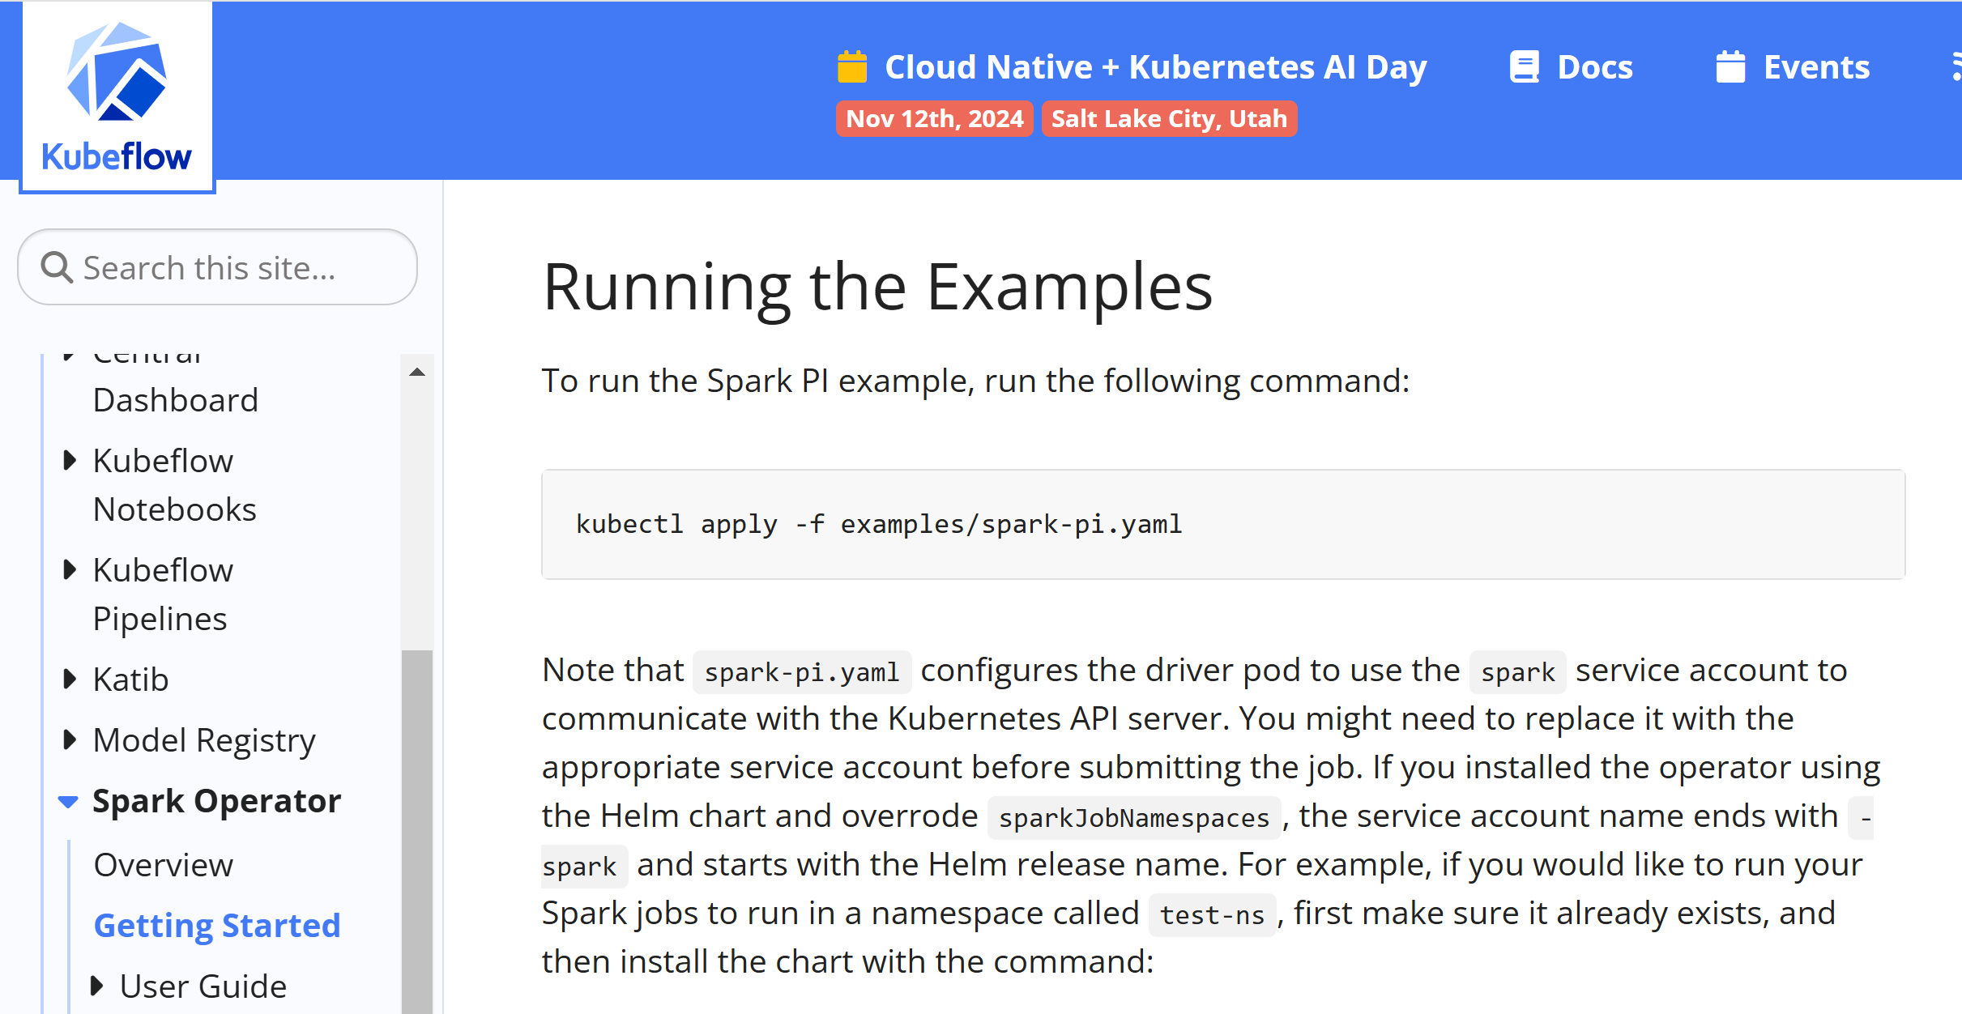
https://www.kubeflow.org/docs/components/spark-operator/getting-started/#configuration

Slide 46
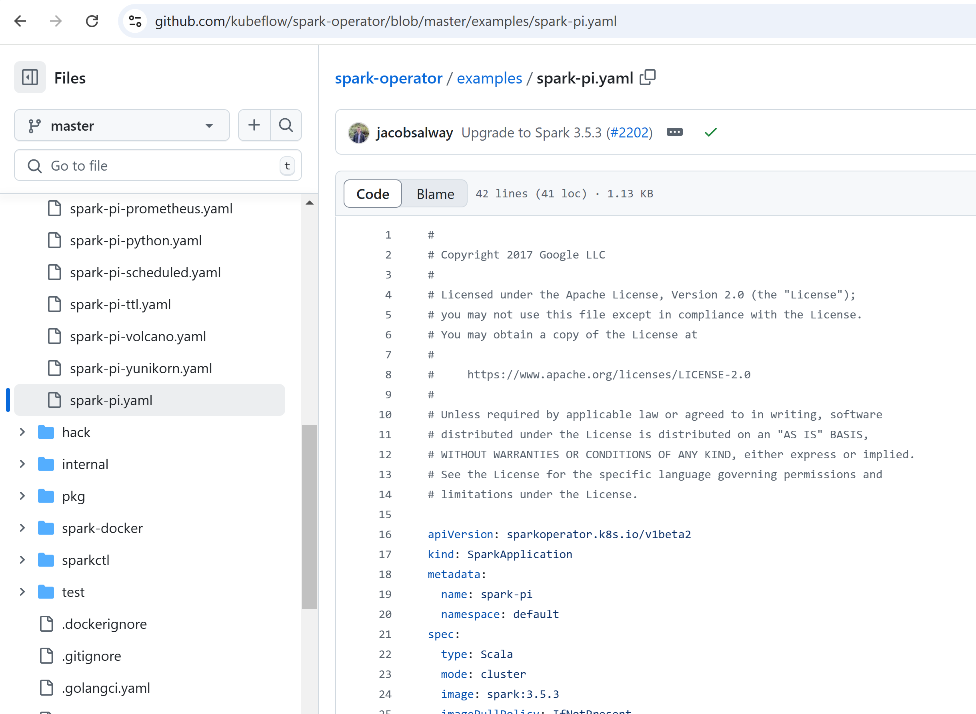
https://github.com/kubeflow/spark-operator/blob/master/examples/spark-pi.yaml

Slide 47
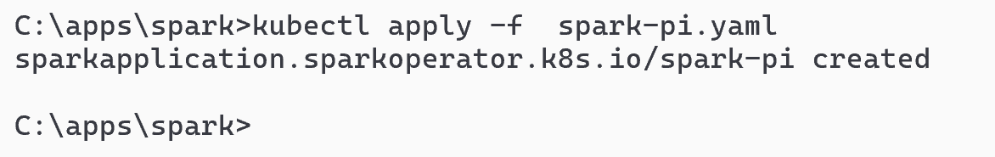
Download file + k apply
kubectl apply -f spark-pi.yaml

Slide 48
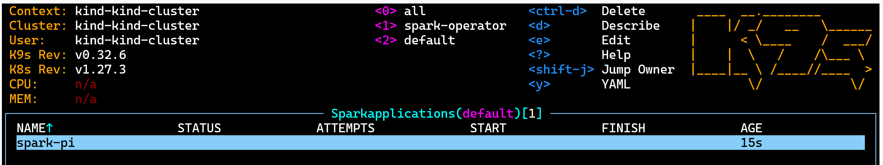
Step 1/3: sparkApplication status = " " (empty) ... spark-operator has not done spark-submit yet

Slide 49
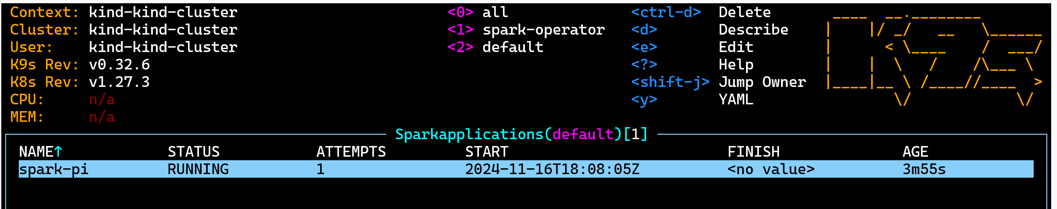
Step 2/3: sparkApplication status = RUNNING

Slide 50
kubectl get sparkApplication (list) status=RUNNING

Slide 51
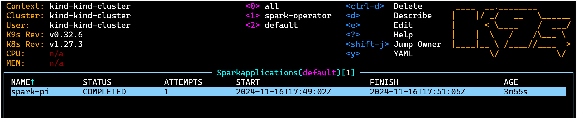
Step 3/3: sparkApplication status=COMPLETED

Slide 52
kubectl get sparkApplication (list) ... COMPLETED

Slide 53
kubectl apply AGAIN unchanged? => Does nothing
Unchanged => nothing is done.. K8s will not delete, nor restart anything
k apply does not "launch", it just write the desired state to be "a sparkApp should exist"

Slide 54
kubectl delete sparkApplication spark-pi
Notice:
- you apply using file name "spark-pi.yaml"
- you can delete the sparkApp (only it) by its type + resource name "spark-pi"
- or by full name "sparkAplpication/spark-pi"
- or delete all resources from yaml file

Slide 55
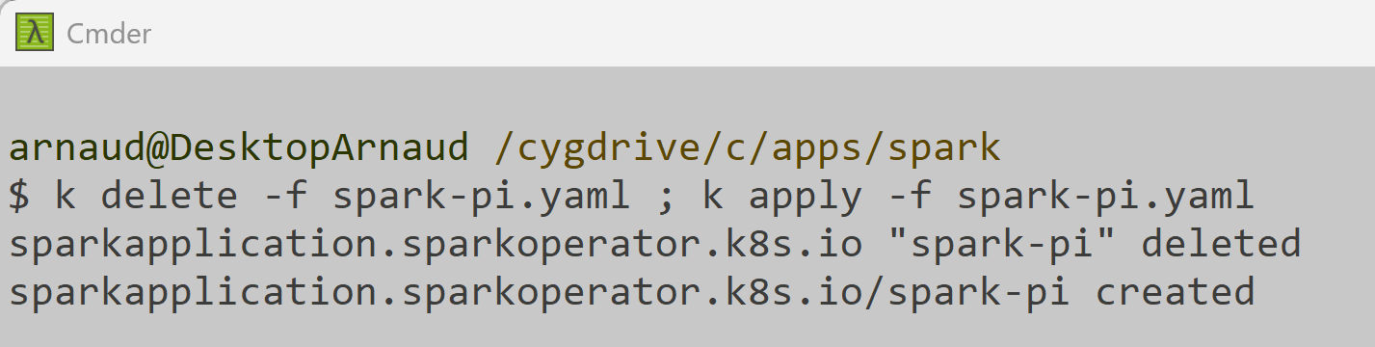
force relaunch on unix Bash kubectl delete ; kubectl apply
NOTICE:
using unix "Bash $" shell, you can do "cmd1 ; cmd2" to execute sequentially on 1 line
But on cmd DOS c:>, you can't use ";" !
do not use "&&" which would stop on delete error !!
It is OK if the "kubectl delete " does not find anything to delete.

Slide 56
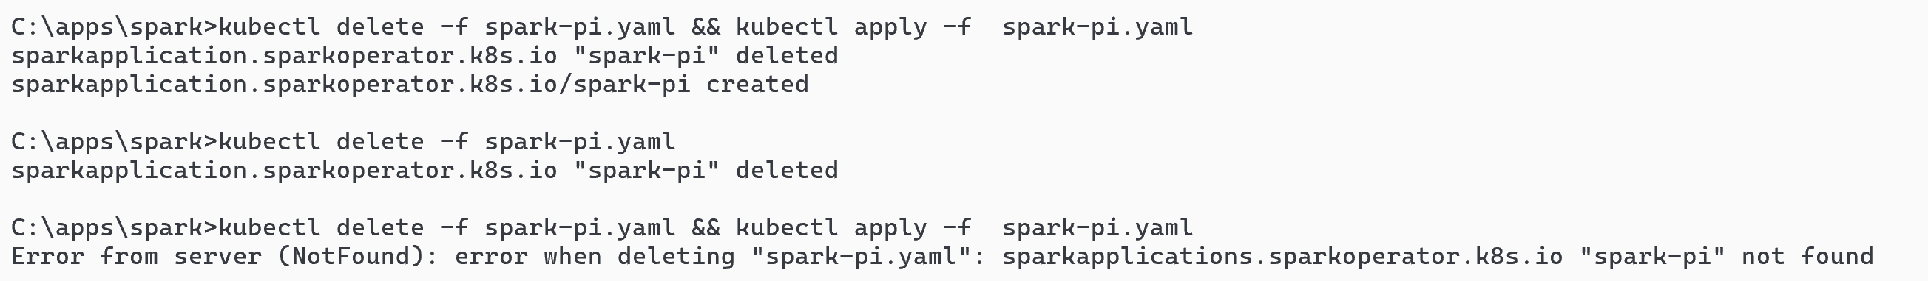
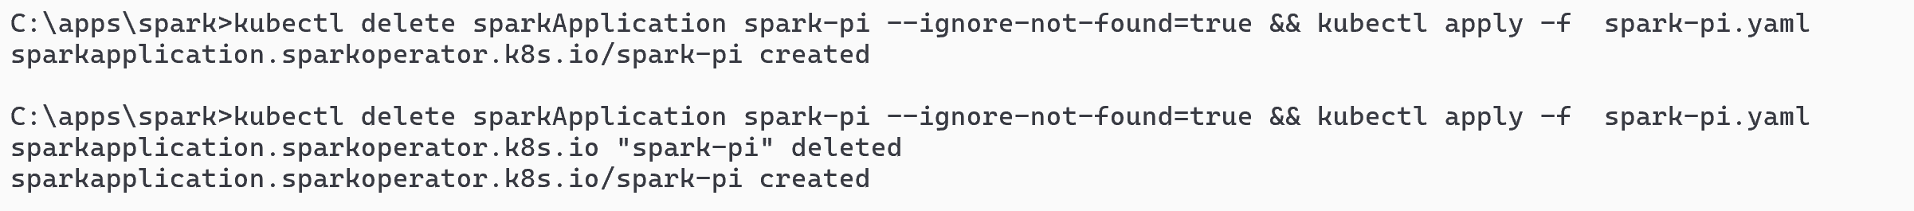
on Cmd Dos : && does not work you need "--ignore-no-found=true"
OK when it existed: deleted , then created
ERROR when it did not exist: deleted, but not re-created !
OK
OK

Slide 57
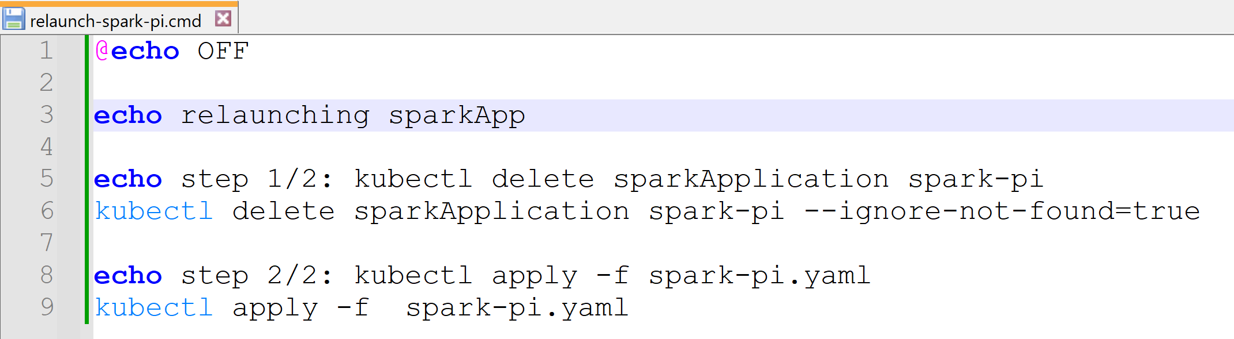
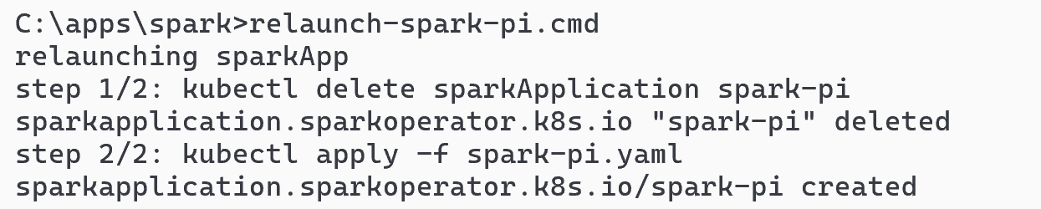
Use helper ".cmd" File script

Slide 58
Next Steps
Try to change yaml file, to
- add "sparkConf" configuration
- change driver/executor config (memory, number of executors, etc..)
- add configMap + mount as volume for reading file
- add PVC
- add PVC for internal shuffling directories
- add toleration for NodePool taints
- etc etc
Try to open ingress equivalent of http://localhost:4040 (or port-forward)
Try to attach debugger (remote debug JVM process)

Slide 59
Next Advanced Steps (maybe Demo in Course)
create an Azure AKS cluster
launch from local "kubectl" command to remote Azure Kubernetes
configure several NodePools
1 "on-demand" : small but "normal price" VM for the spark-driver
1 "spot" : Big memory VMs but "Spot Instance" VM for executors
port-forward http://localhost:4040 for driver pod 4040
port-forward 5005 for remote debug from local PC in IntelliJ !!
mount volume from configMap
+ volume file from KeyVault (for password secrets)
use "managed-identity"
etc etc

Slide 60
Questions ?
arnaud.nauwynck@gmail.com

